Slide 1
USACE NEW ENGLAND DISTRICT CAPE POGE
WWII AIRCRAFT RECOVERY
Under the Formerly Used Defense Site Program (FUDS)
May-June 2019
Carol Ann Charette
US Army Corps of Engineers Project Manager, PMP

Slide 2
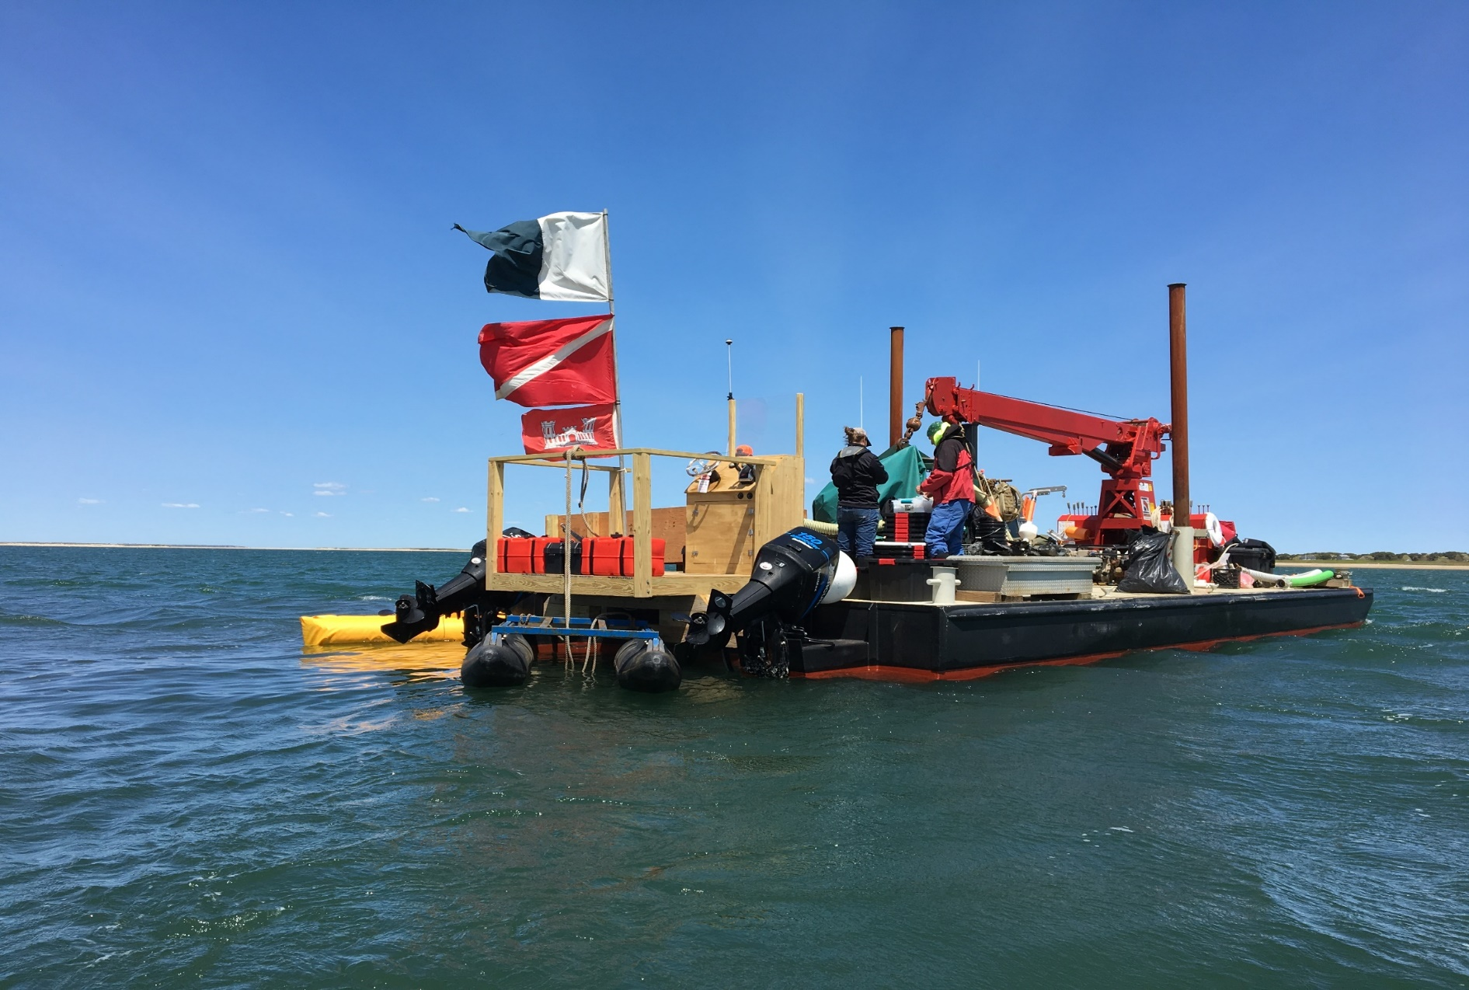
Barge Used for Aircraft Recovery

Slide 3
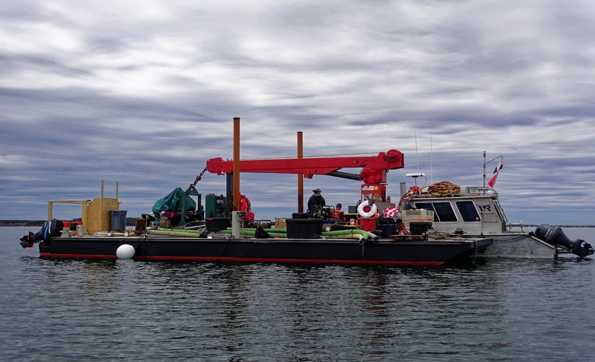
Barge with VRH Dive Boat

Slide 4
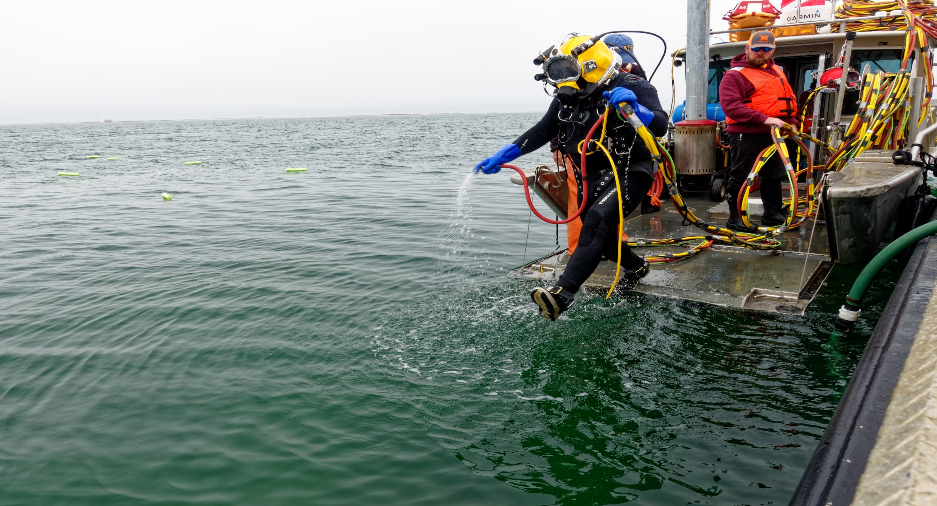
Diver Jumping Off Dive Boat

Slide 5
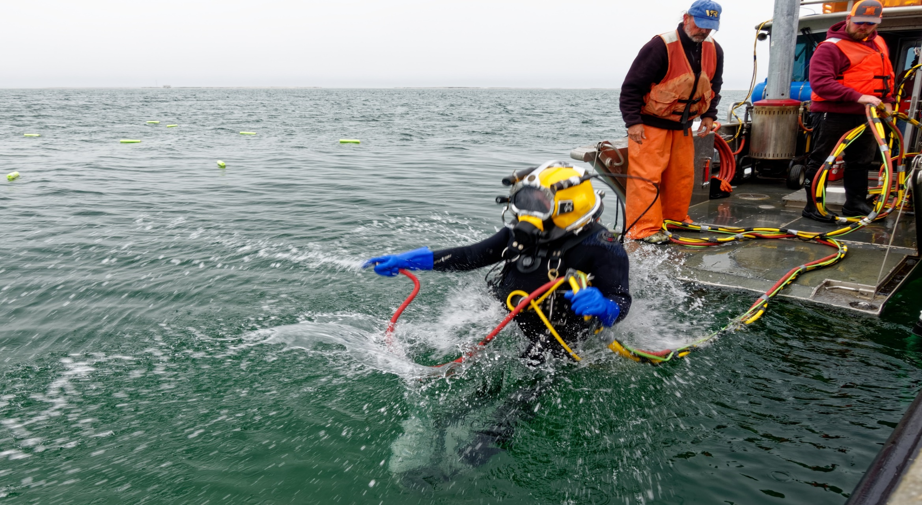
Diver Entering Water

Slide 6
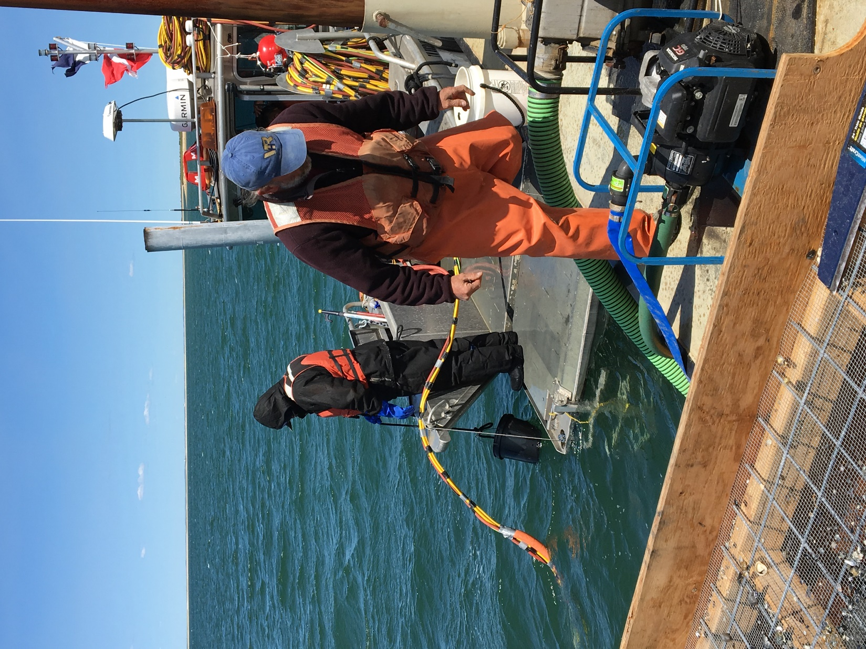
Support Staff Lowering Empty Artifact Bucket Into Water

Slide 7
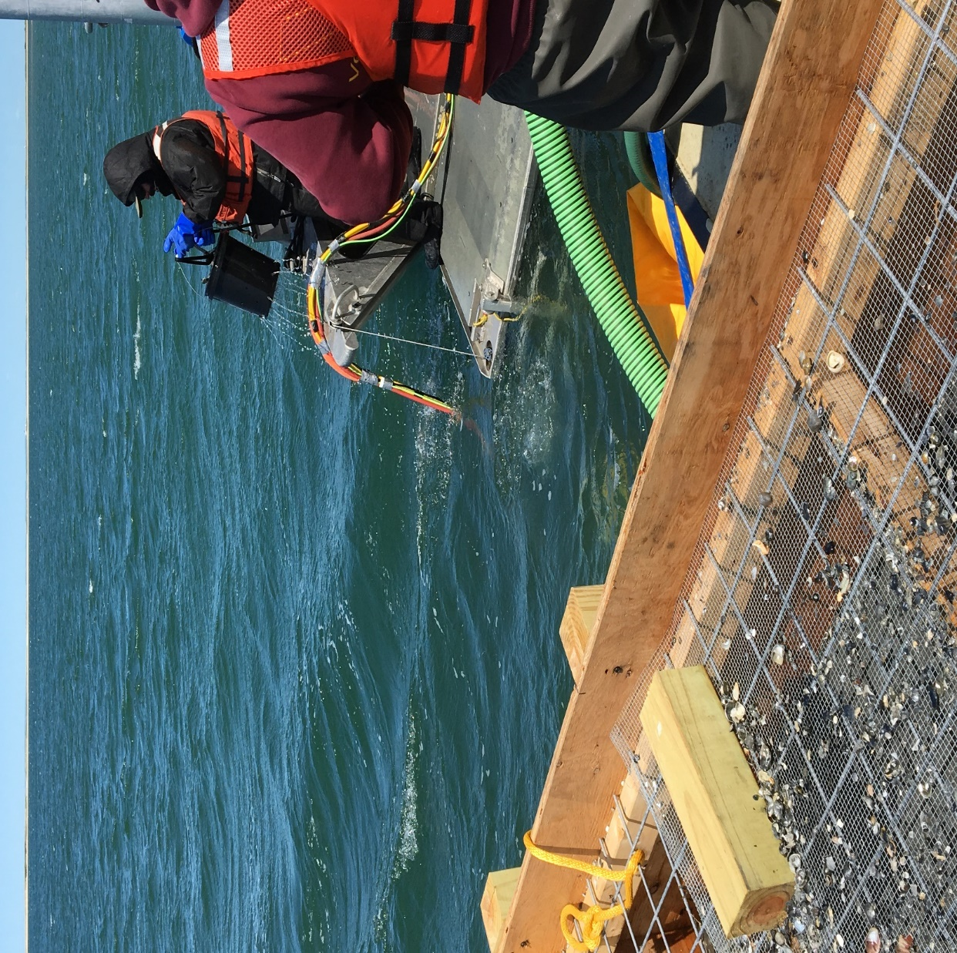
Staff Raising Filled Artifact Bucket (holes in bucket for draining water)

Slide 8
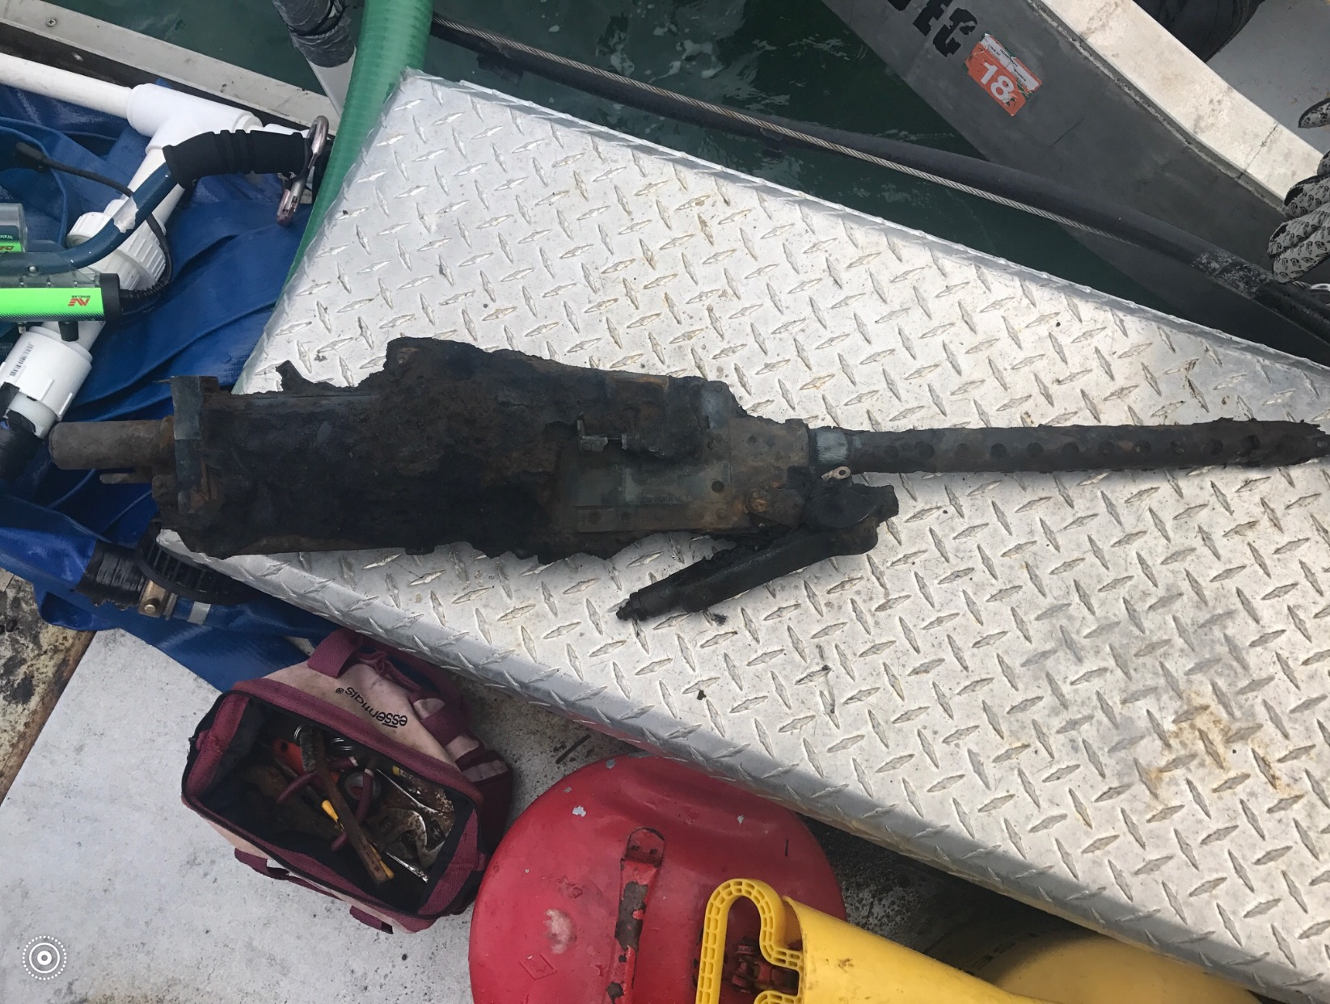
Recovered Artifacts Aircraft Browning .30 Caliber Machine Gun

Slide 9
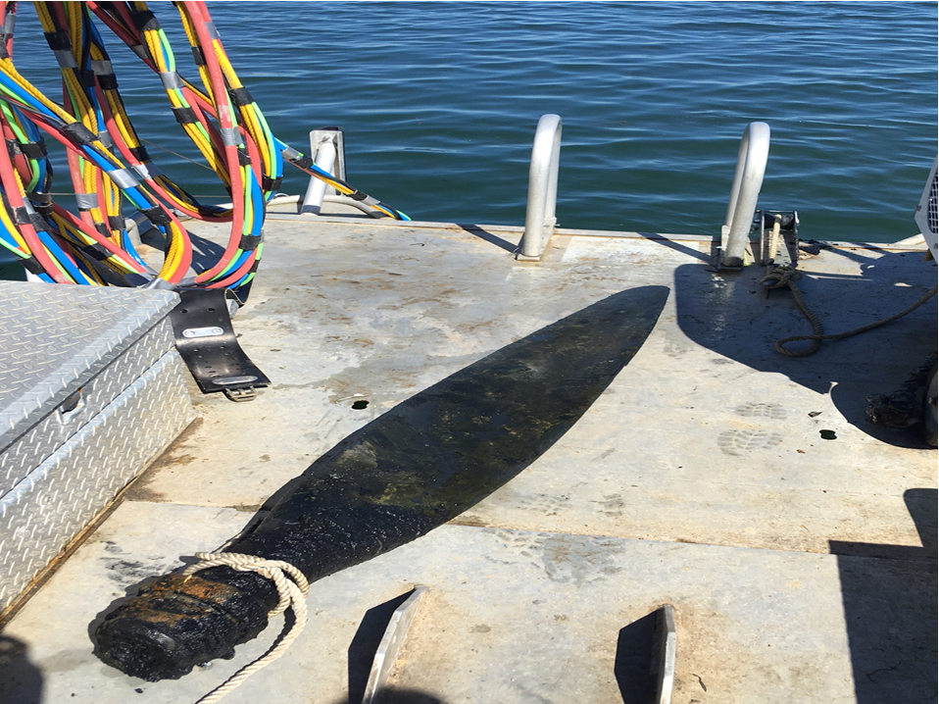
Aircraft Propeller Blade

Slide 10
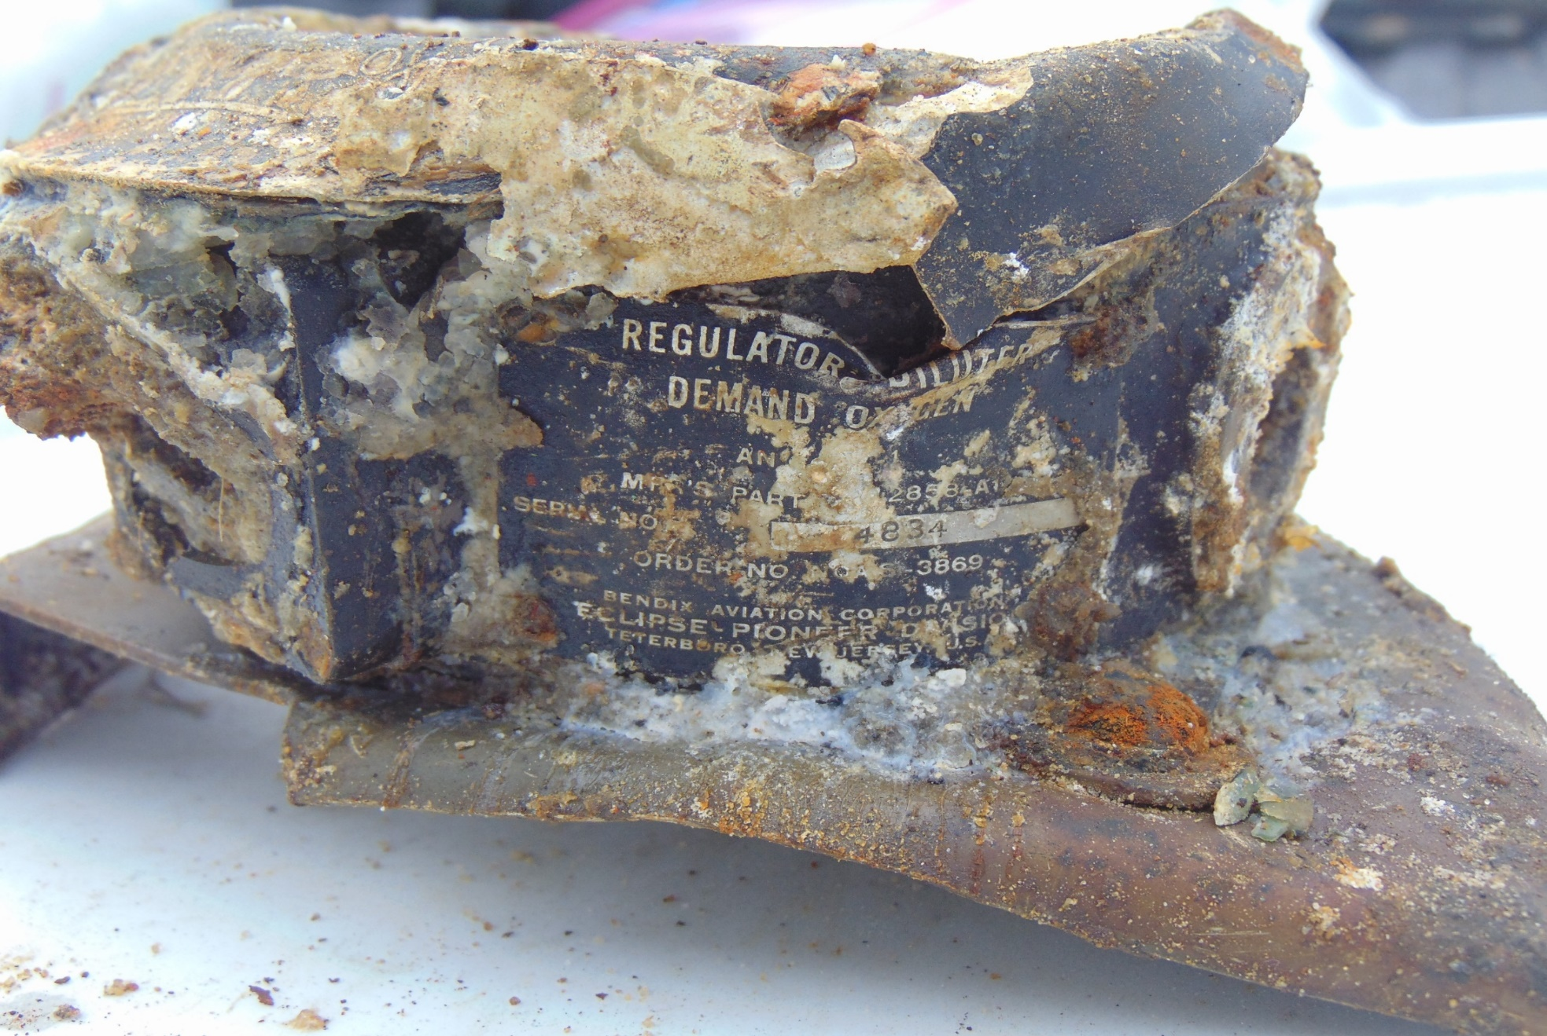
Aircraft Oxygen Regulator

Slide 11
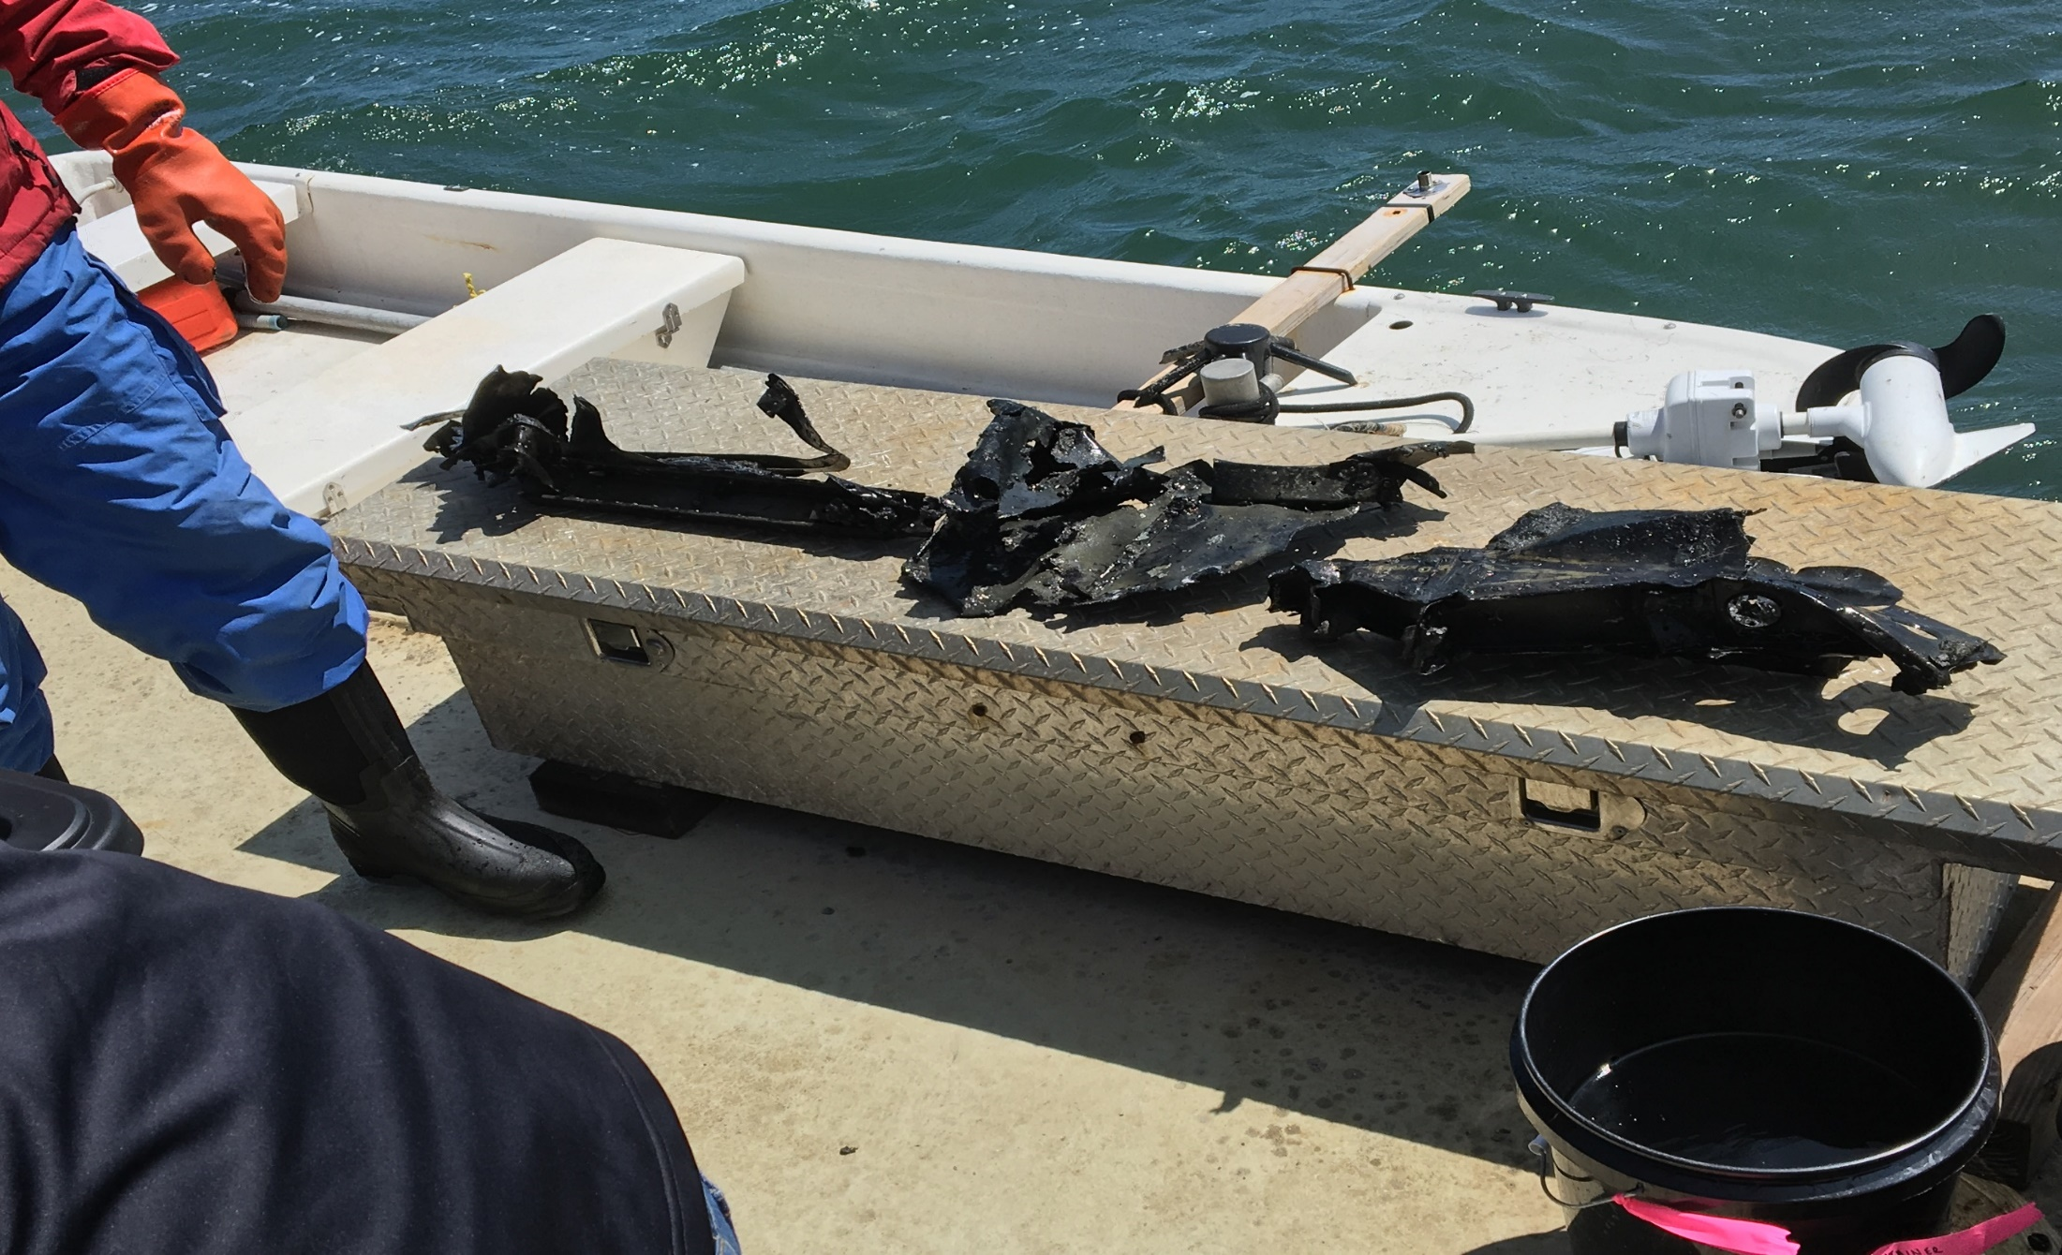
Miscellaneous Aircraft Artifacts

Slide 12
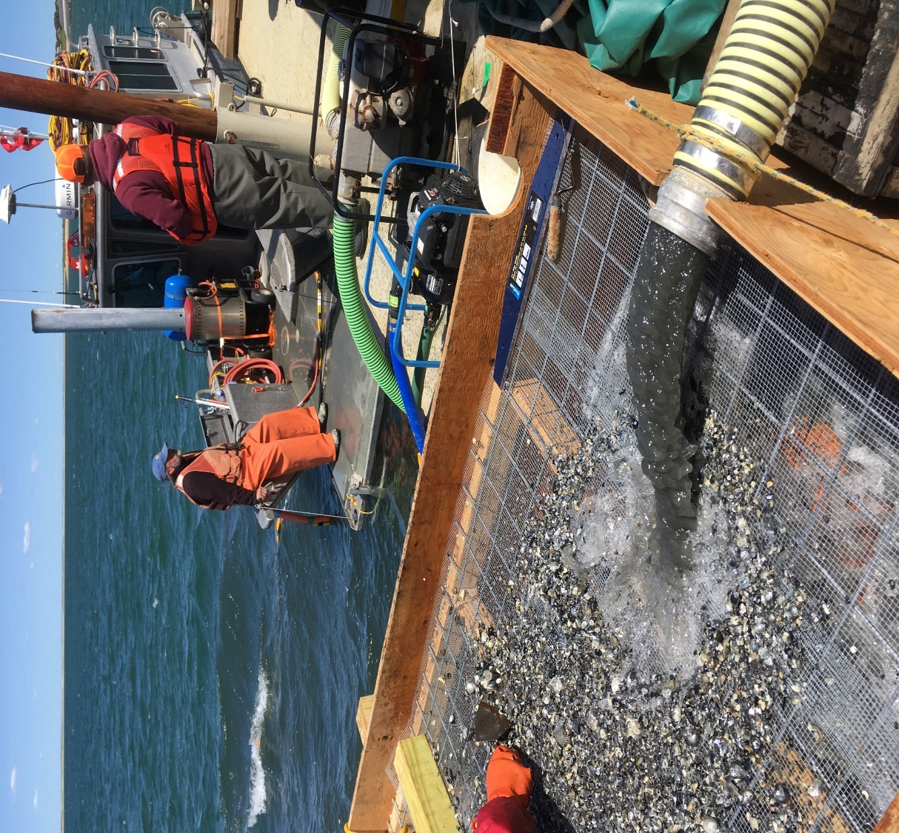
Sifting/Screening Operation for Smaller Items (1/4 inch Sieve)

Slide 13
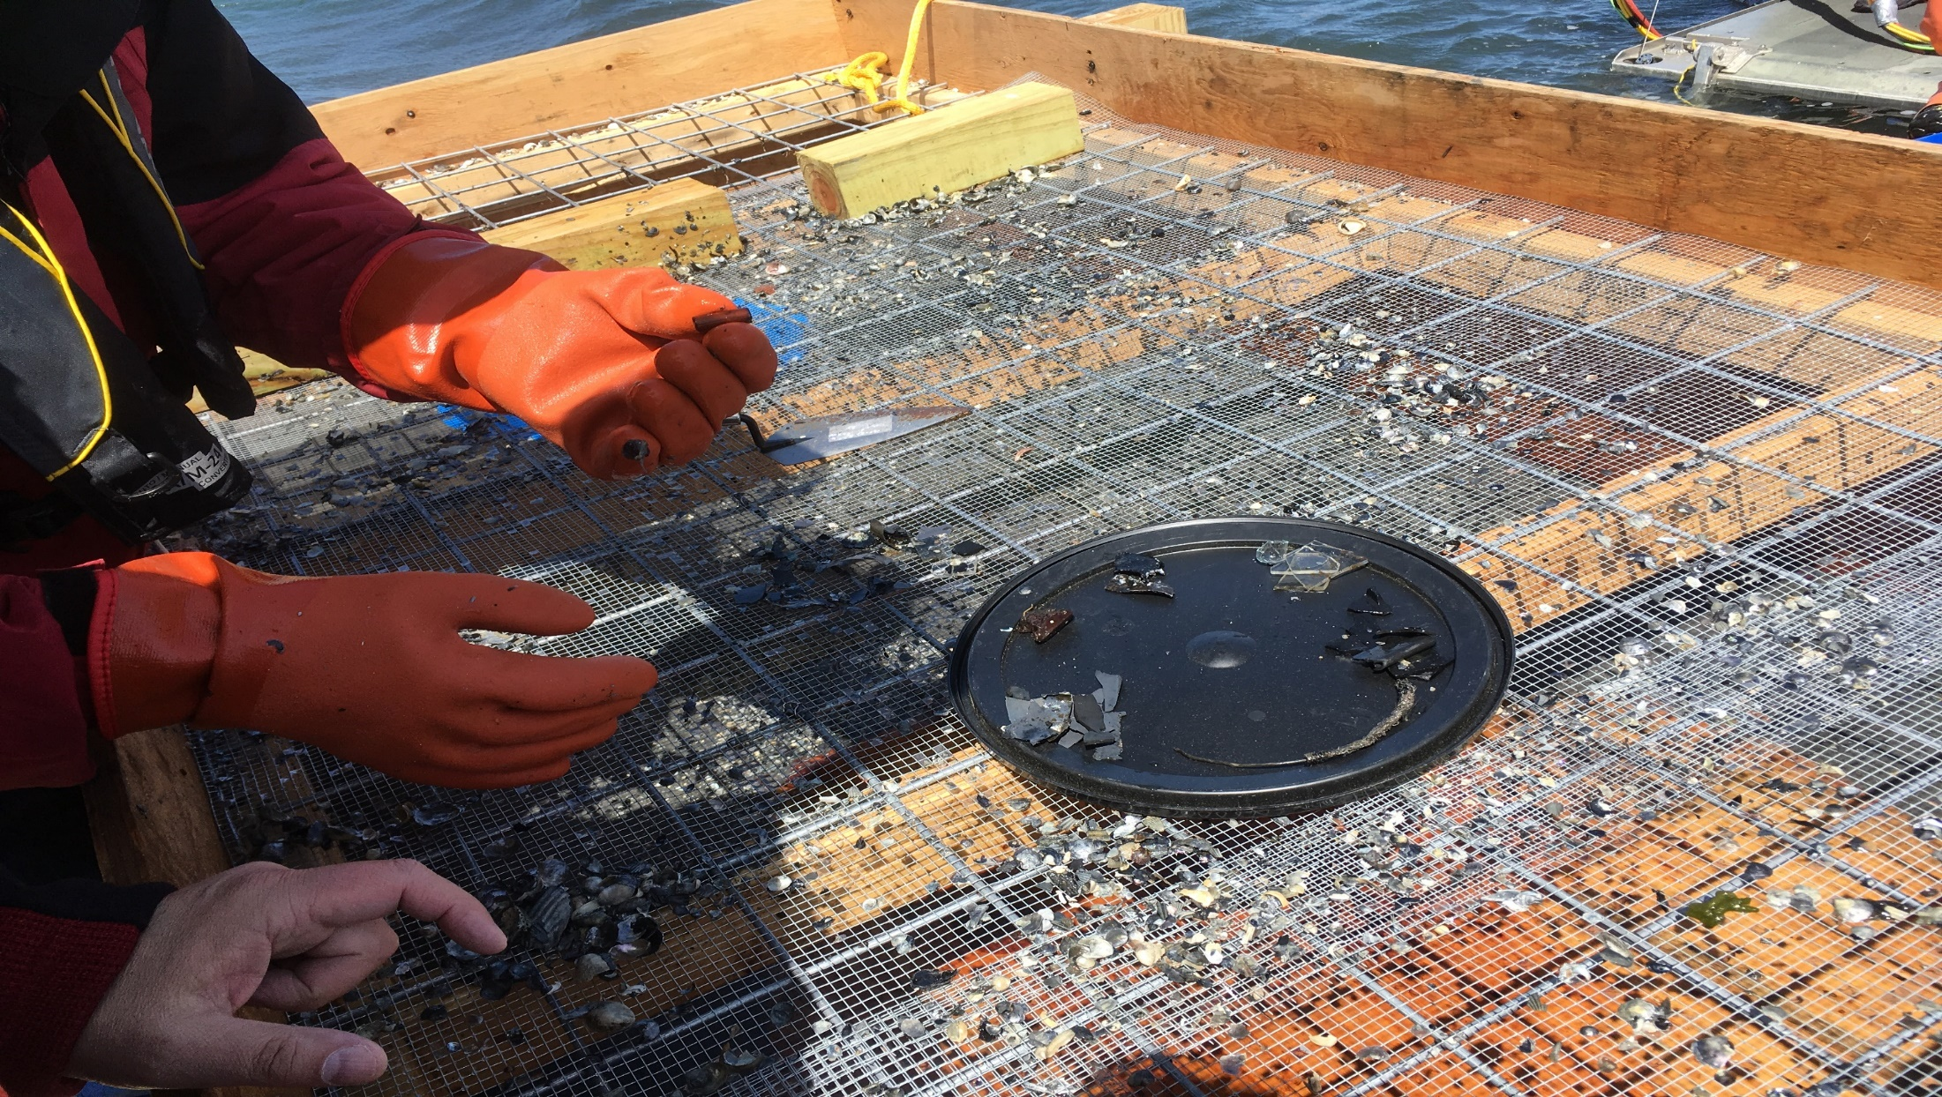
Small Aircraft Artifacts Recovered as a Result of Sifting/Screening Operations

Slide 14
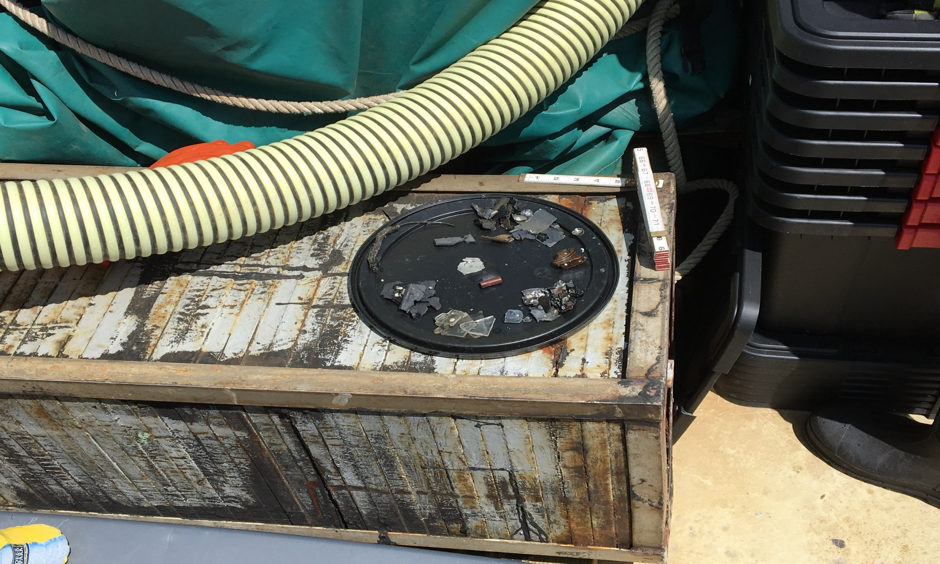
Additional Small Aircraft Artifacts

Slide 15
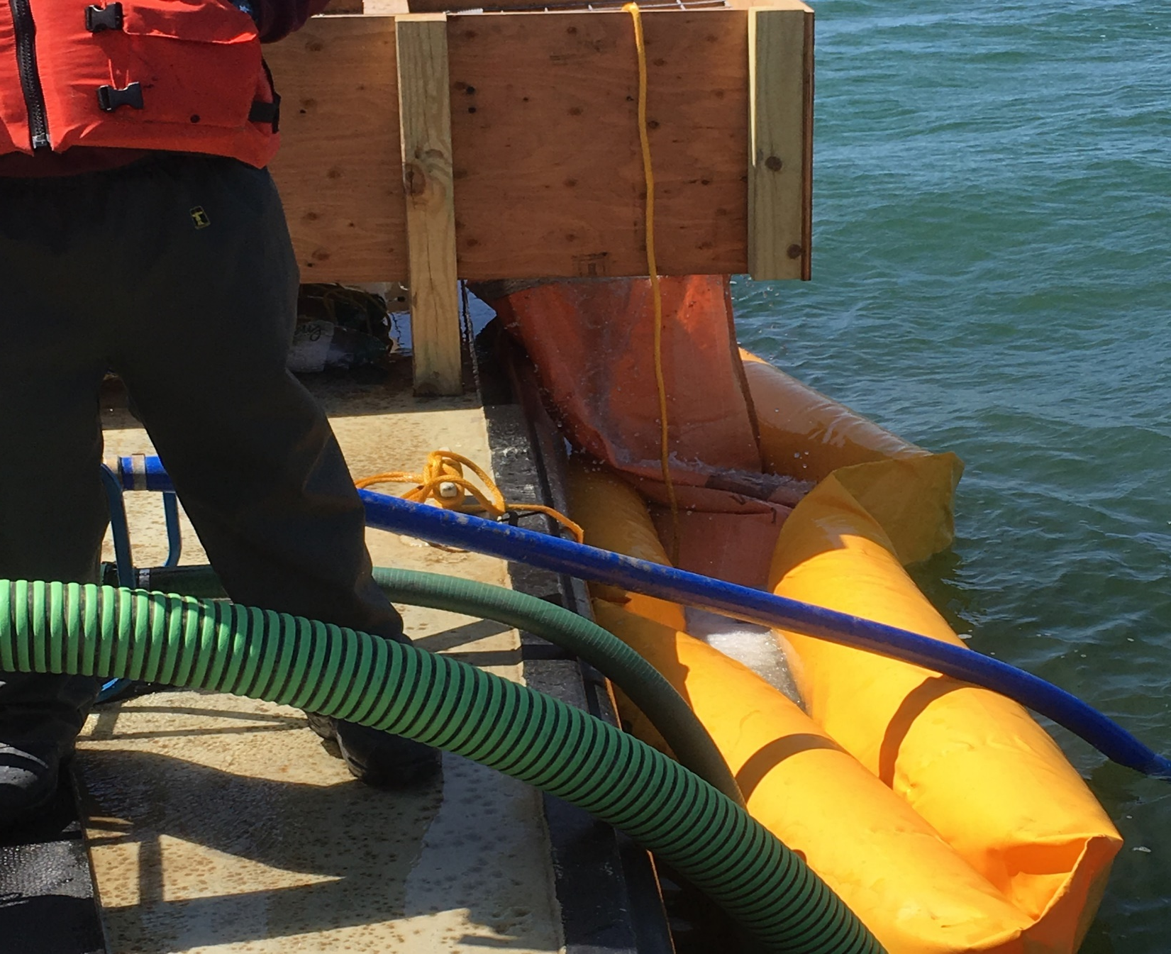
Silt Screen Capturing Sediment in Localized Area from Sifting/Screening Operation

Slide 16
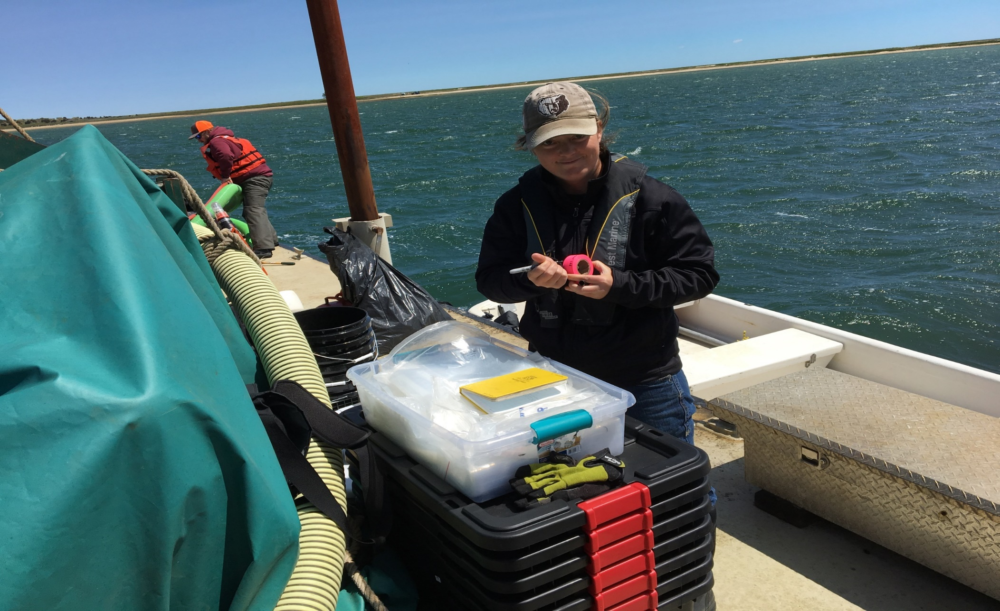
Archeologist Cataloguing/Inventorying Retrieved Artifacts

Slide 17
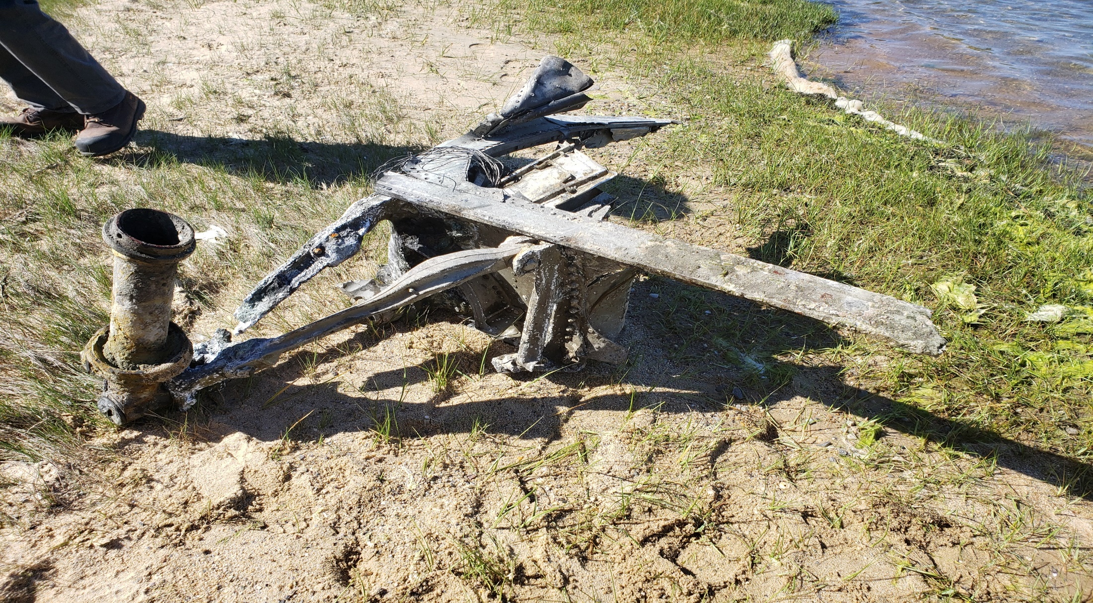
Examples of Larger Recovered Artifacts Part of Left Hand Landing Gear Support Structure with Retract Cylinder

Slide 18
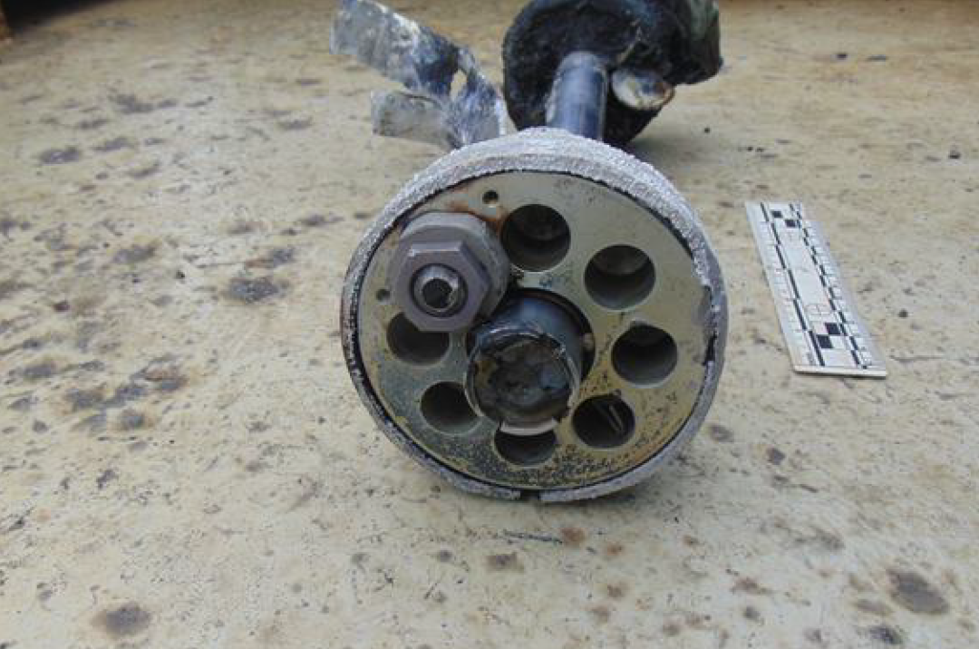
Stainless Shaft and Heads w/Fittings and Plating Hydraulic Cylinder Possible Landing Gear Retreat

Slide 19
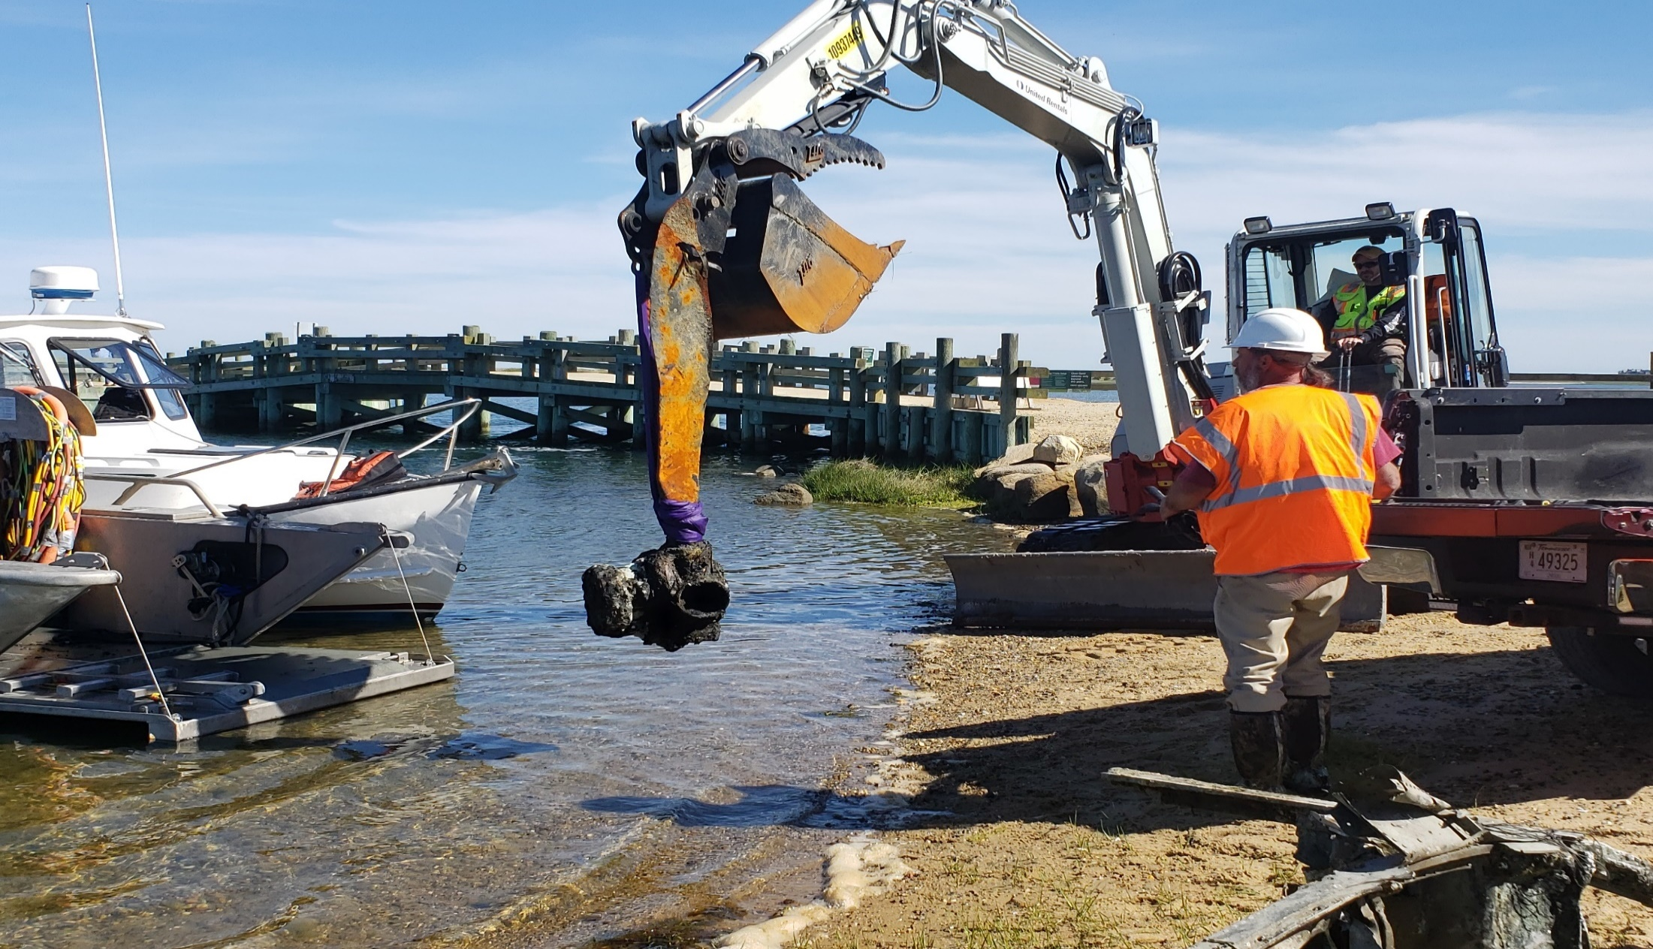
Propeller Blade with Hub Assembly (Curtis Electric Propeller)

Slide 20
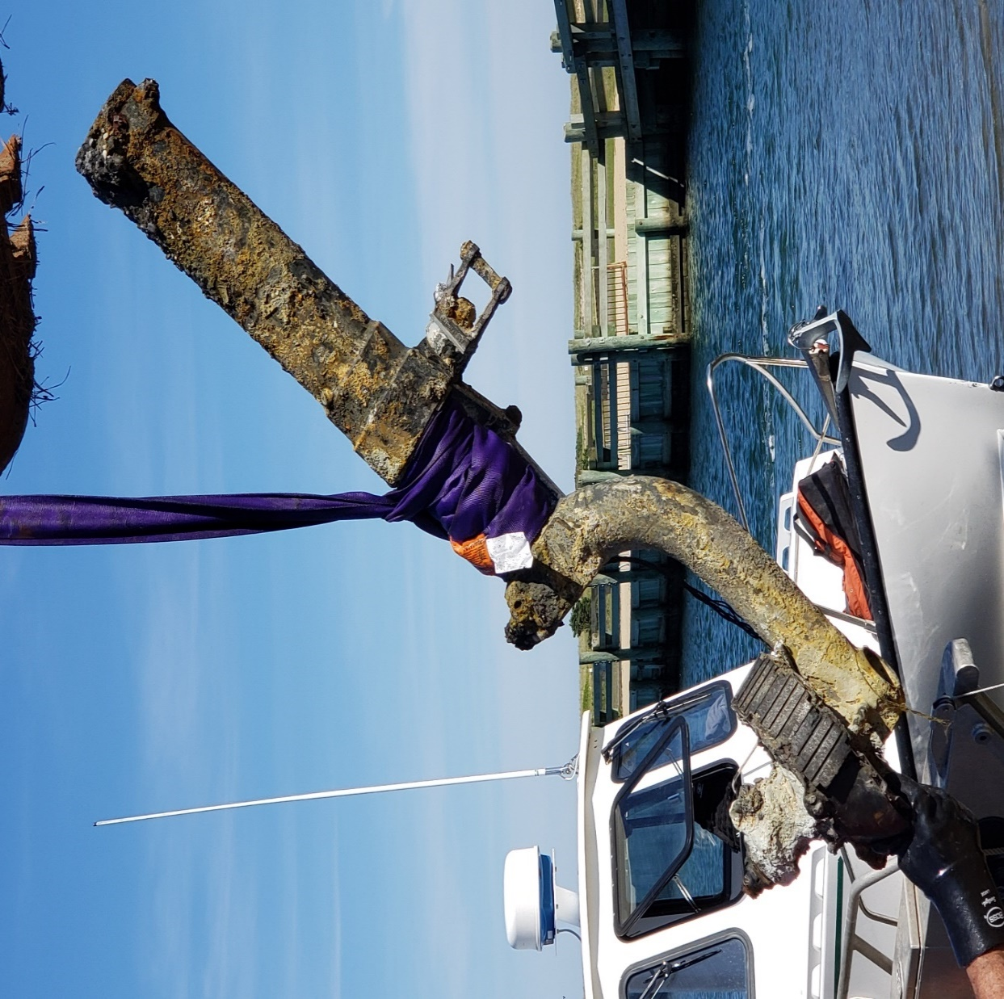
Left Hand Main Landing Gear with Axle

Slide 21
Summary of Aircraft Artifacts Recovered and Their Final Disposition
1,312 WWII Aircraft Artifacts Recovered
208 sent to Texas A&M
96 slated for Conservation Including 2 Browning .30 caliber machine guns and 3 propellers)
109 slated for X-ray and further evaluation
3 slated for research
Once conserved, all artifacts will be curated at the Naval History and Heritage Command and available for loan to museums.
Remainder of aircraft artifacts determined to be insignificant fragmentary debris were documented and shredded/disposed as scrap metal

Slide 22
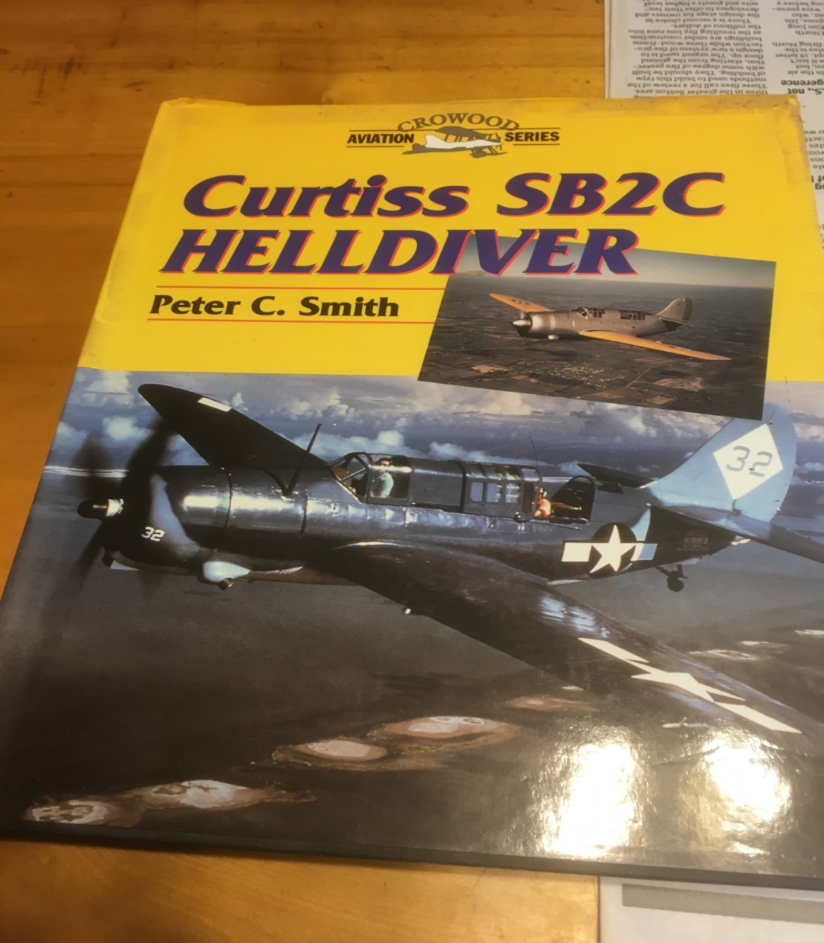
SB2C Aircraft Information SB2C Manual Crowood Aviation Series

Slide 23
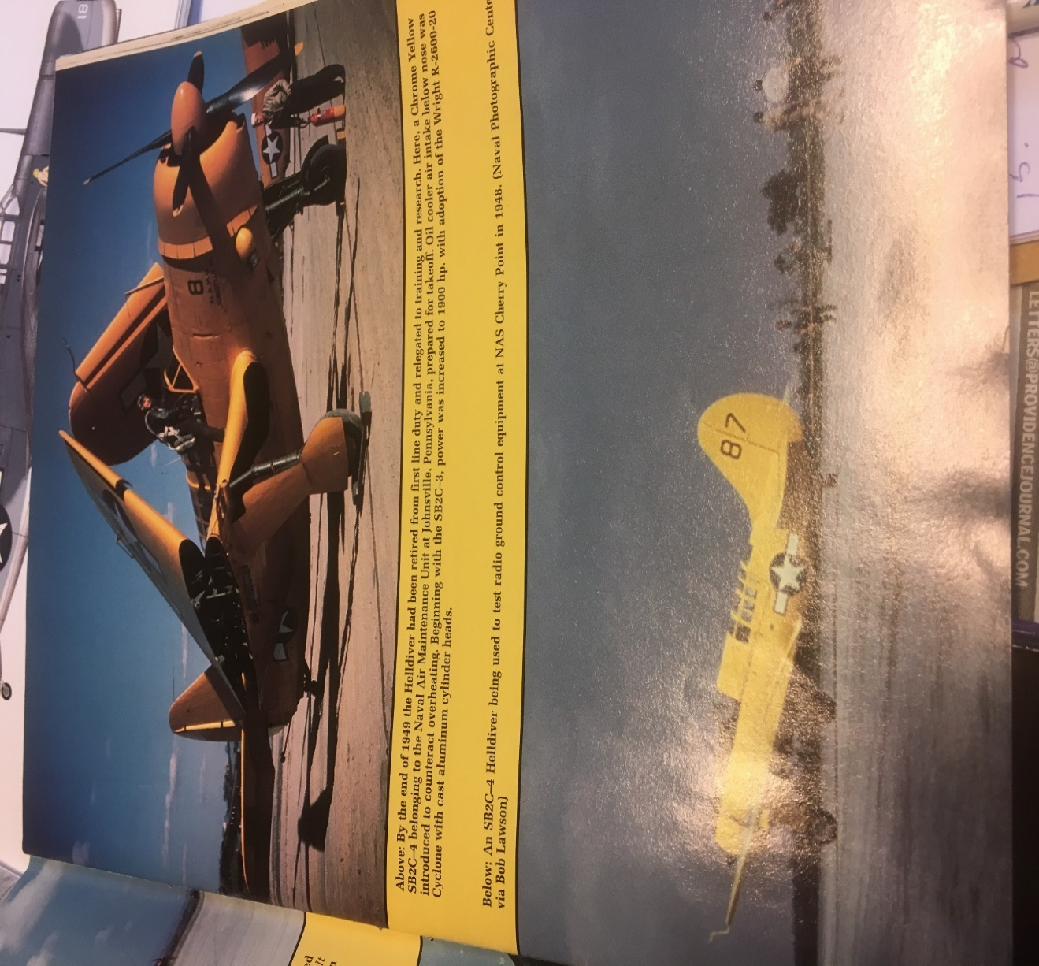
Historical Photo of SB2C-4

Slide 24
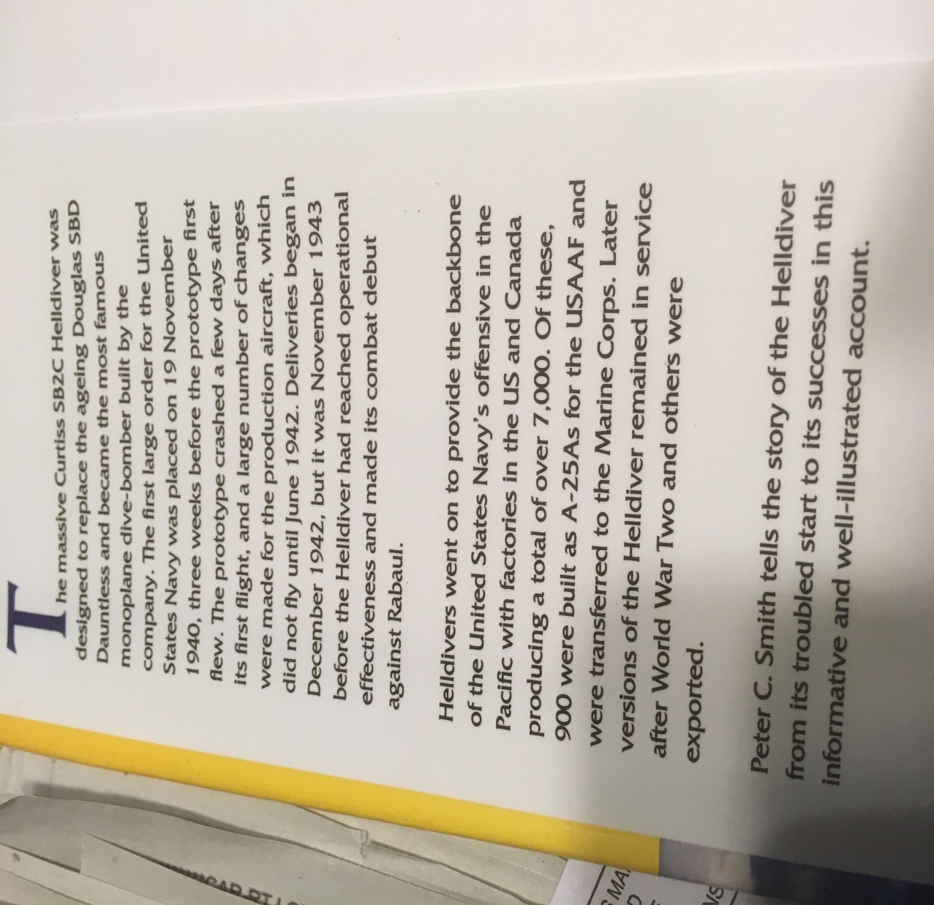
Excerpt from SB2C Crowood Aviation Series

Slide 25
Cape Poge WWII Aircraft Recovery Project Point of Contact
Carol Ann Charette
Project Manager, PMP
US Army Corps of Engineers
Office Phone: 978-318-8605
Cell Phone: 978-505-2918
Email: carol.a.Charette@usace.army.mil

