Slide 1
Downloading Channel Framework from eHydro

Slide 2
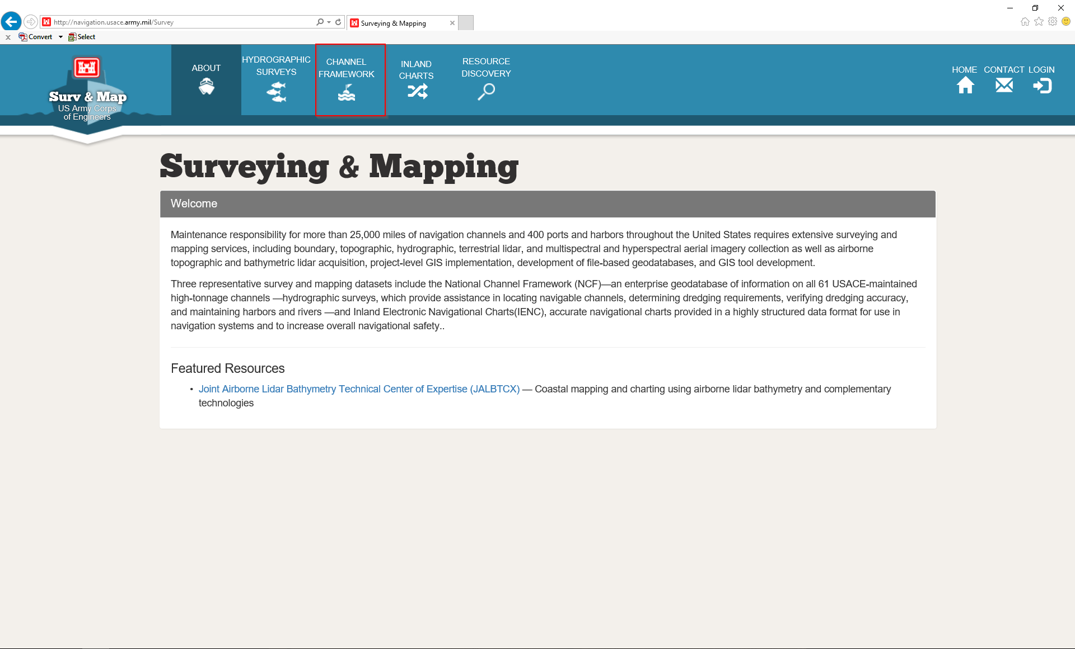
Go to http://navigation.usace.army.mil/Survey
Click “CHANNEL FRAMEWORK” tab at top of page

Slide 3
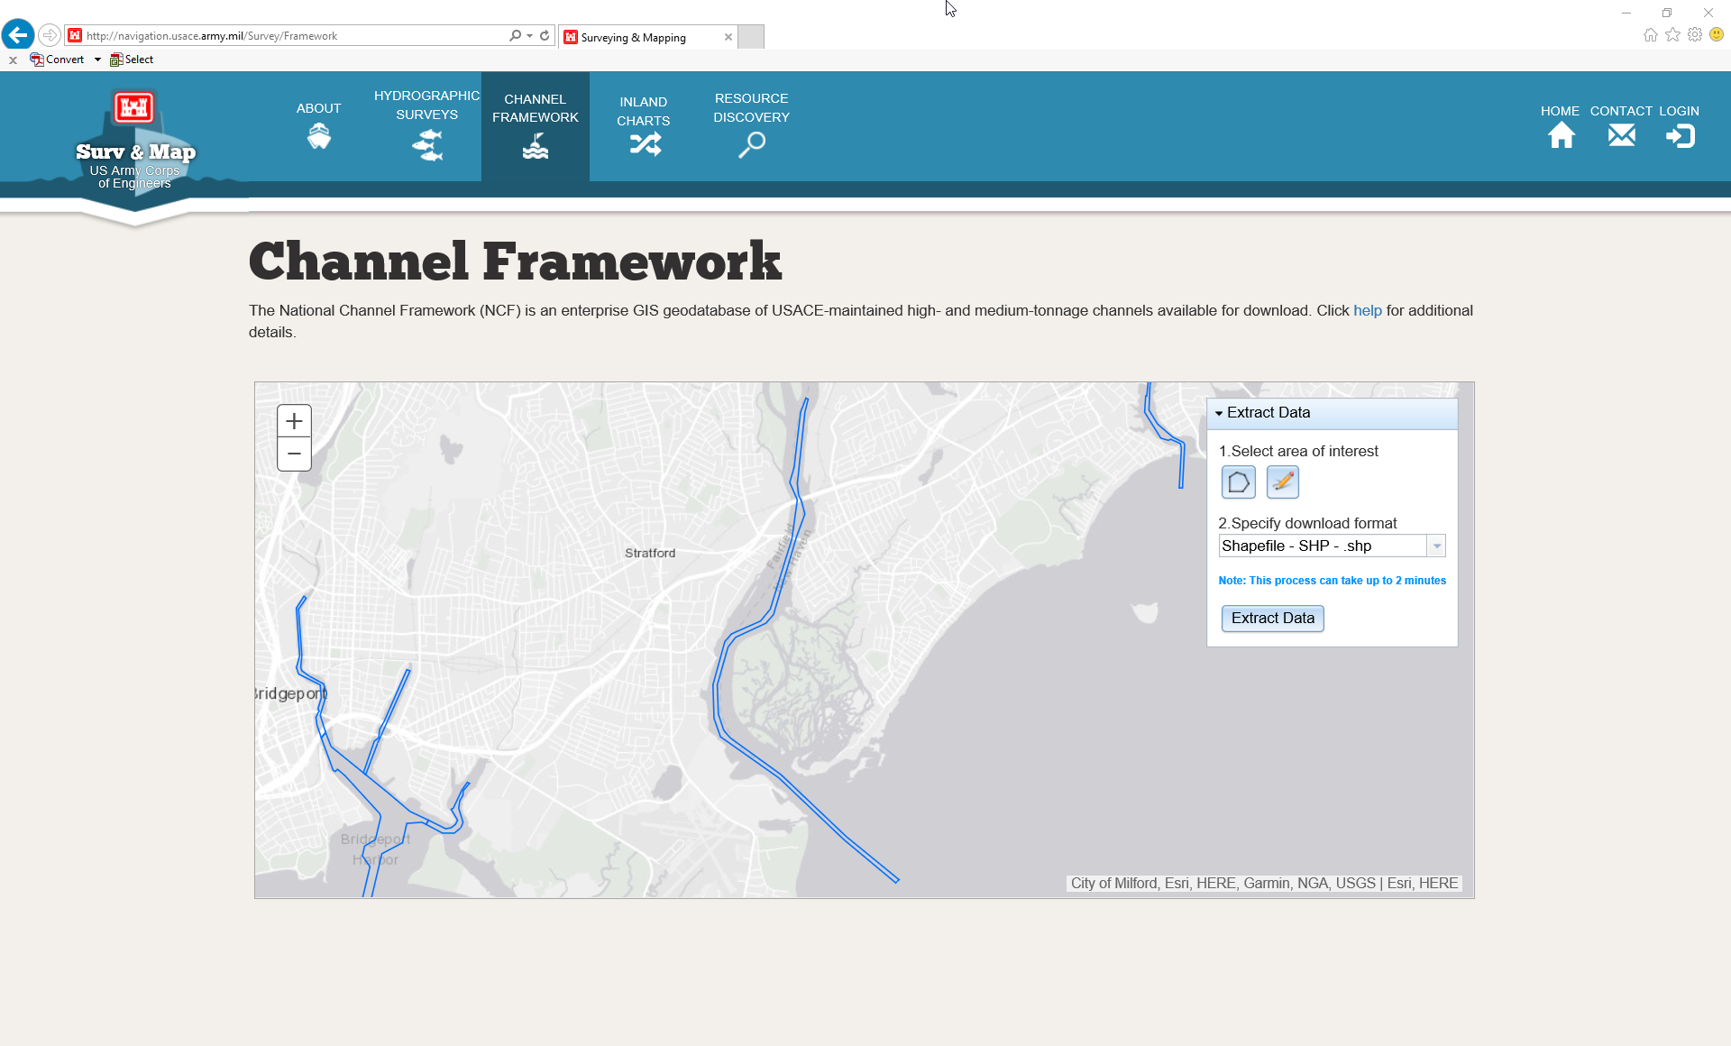
Use the map interface to zoom and pan to your area of interest

Slide 4
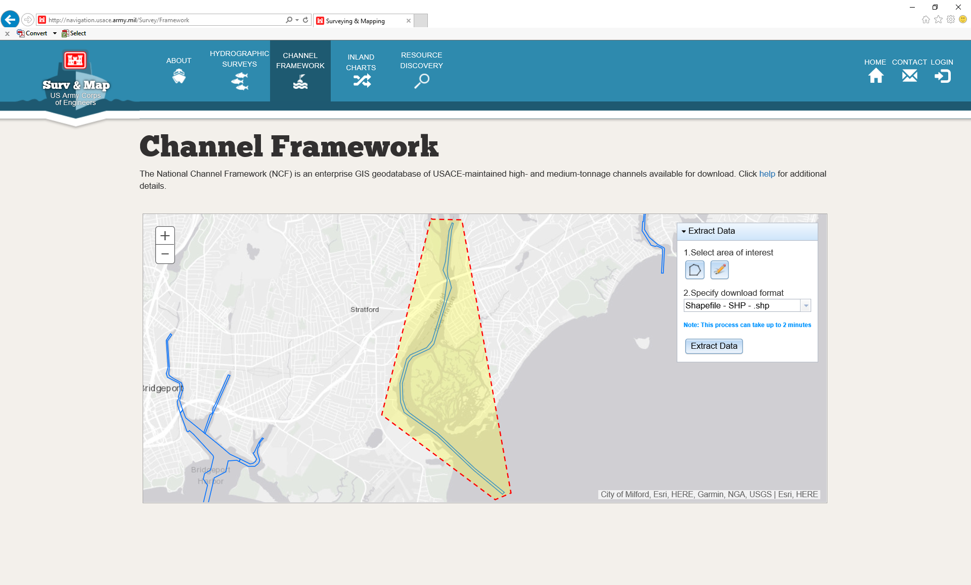
Click on the pencil/polygon tool to draw the area of the channel geometry you want to download
Once you have drawn the area, specify a download format using the drop down menu and click “Extract Data”
The data will download as a .zip file and you will need to save and extract it

Slide 5
Downloading Hydrographic Surveys from eHydro

Slide 6

Go to http://navigation.usace.army.mil/Survey
Click “HYDROGRAPHIC SURVEYS” tab at top of page

Slide 7
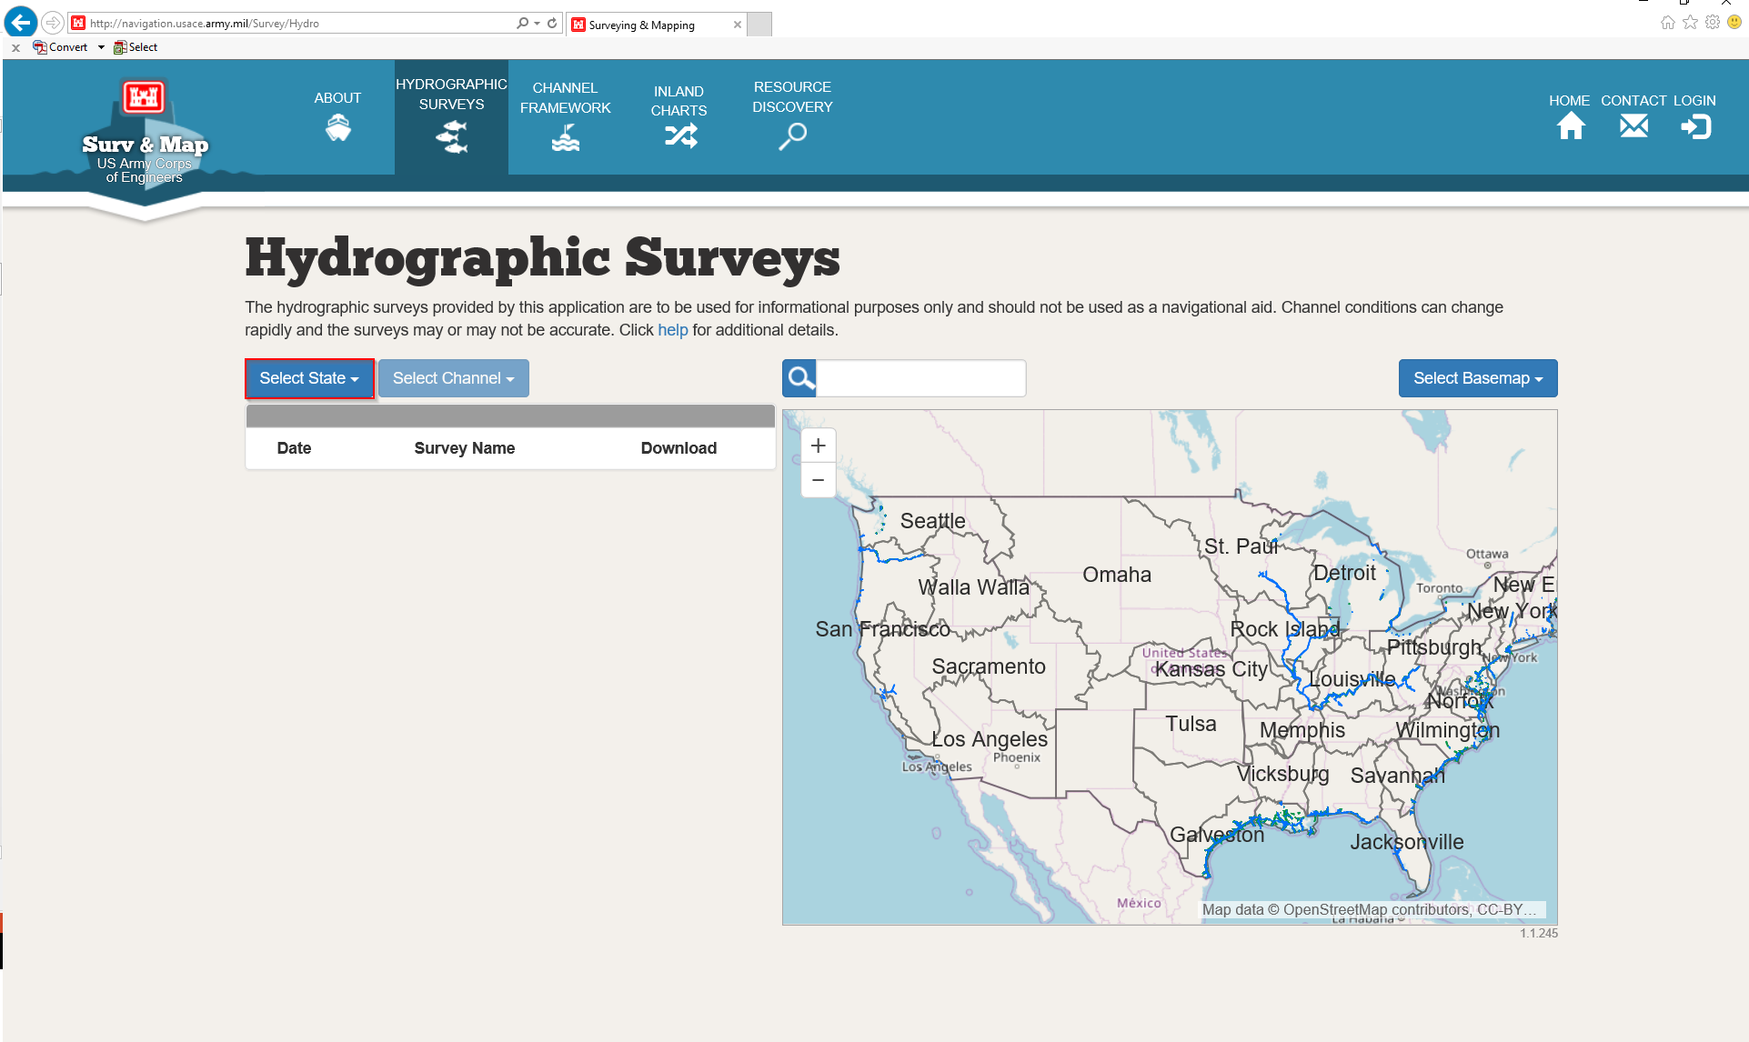
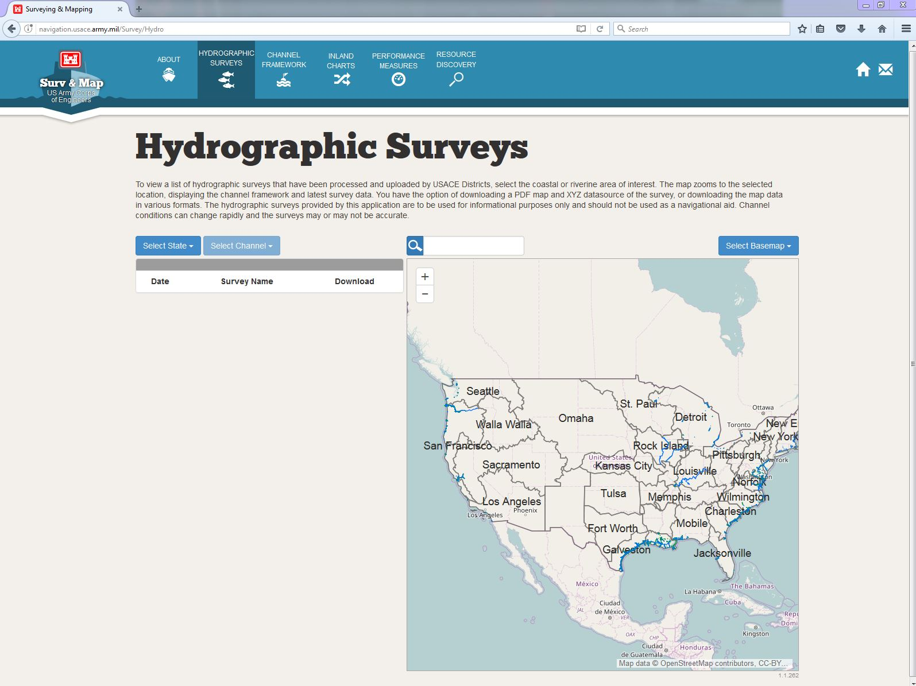

Click on the “Select State” drop down menu
Click “Select State” and navigate to state of interest

Slide 8
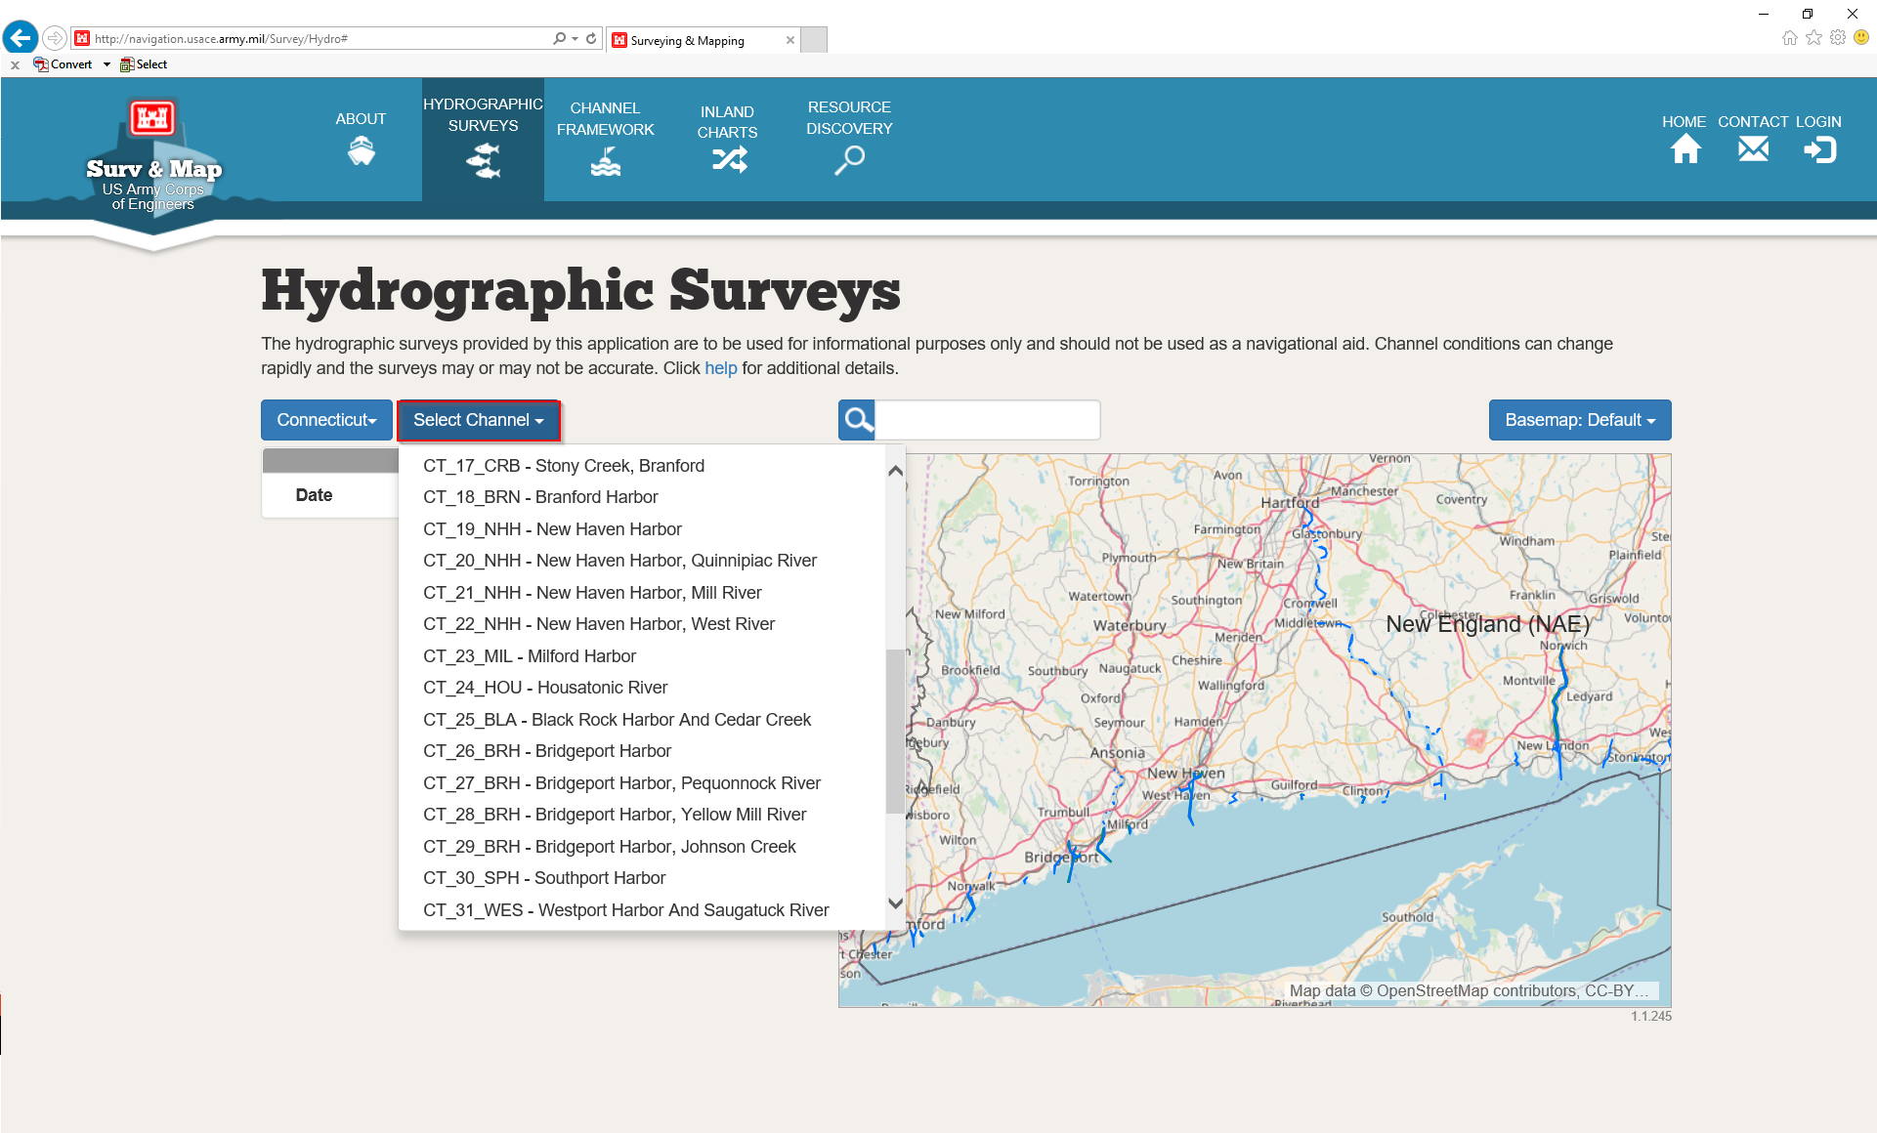
Locate your area of interest using the drop down of project names or by hovering over the map

Slide 9
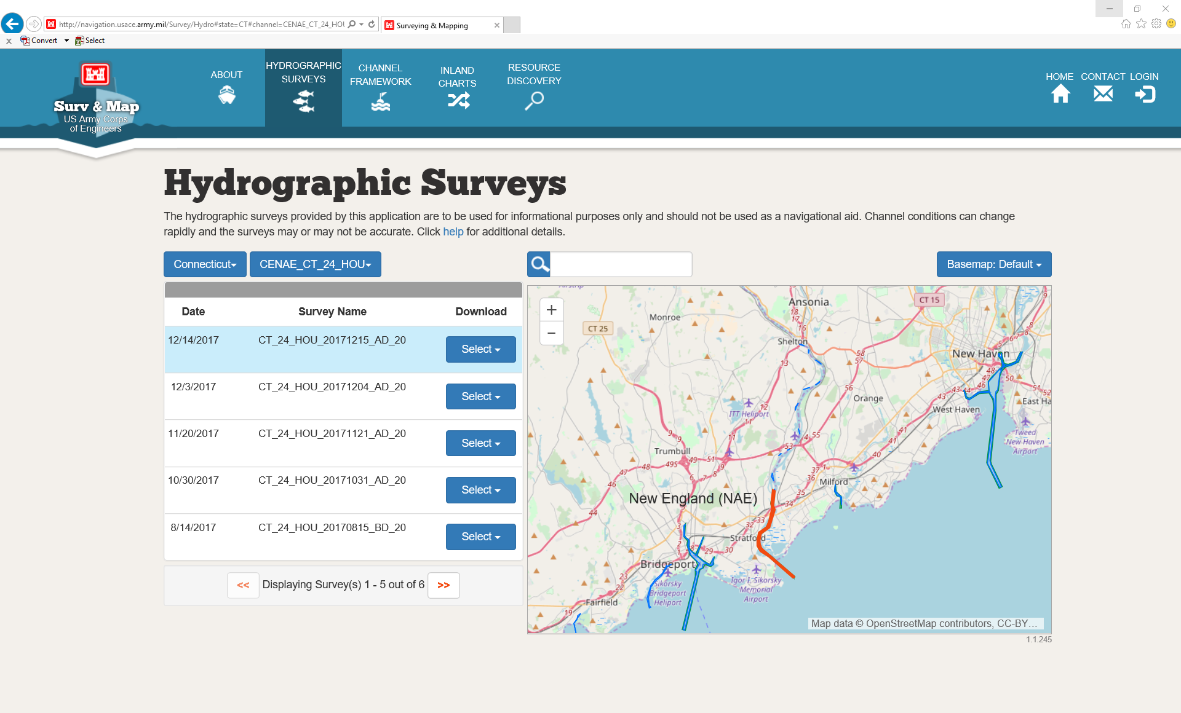
Once you select a project, the map interface will zoom to that area
If you hover the mouse over a Survey Name, it will highlight blue and the area of coverage in the map will highlight red
The Survey Name consists of the full eHydro name and the first date of the survey acquisition in YYYYMMDD form
Annotations at the end of the Survey Name : CS – Condition Survey, BD – Before Dredge, AD – After Dredge

Slide 10
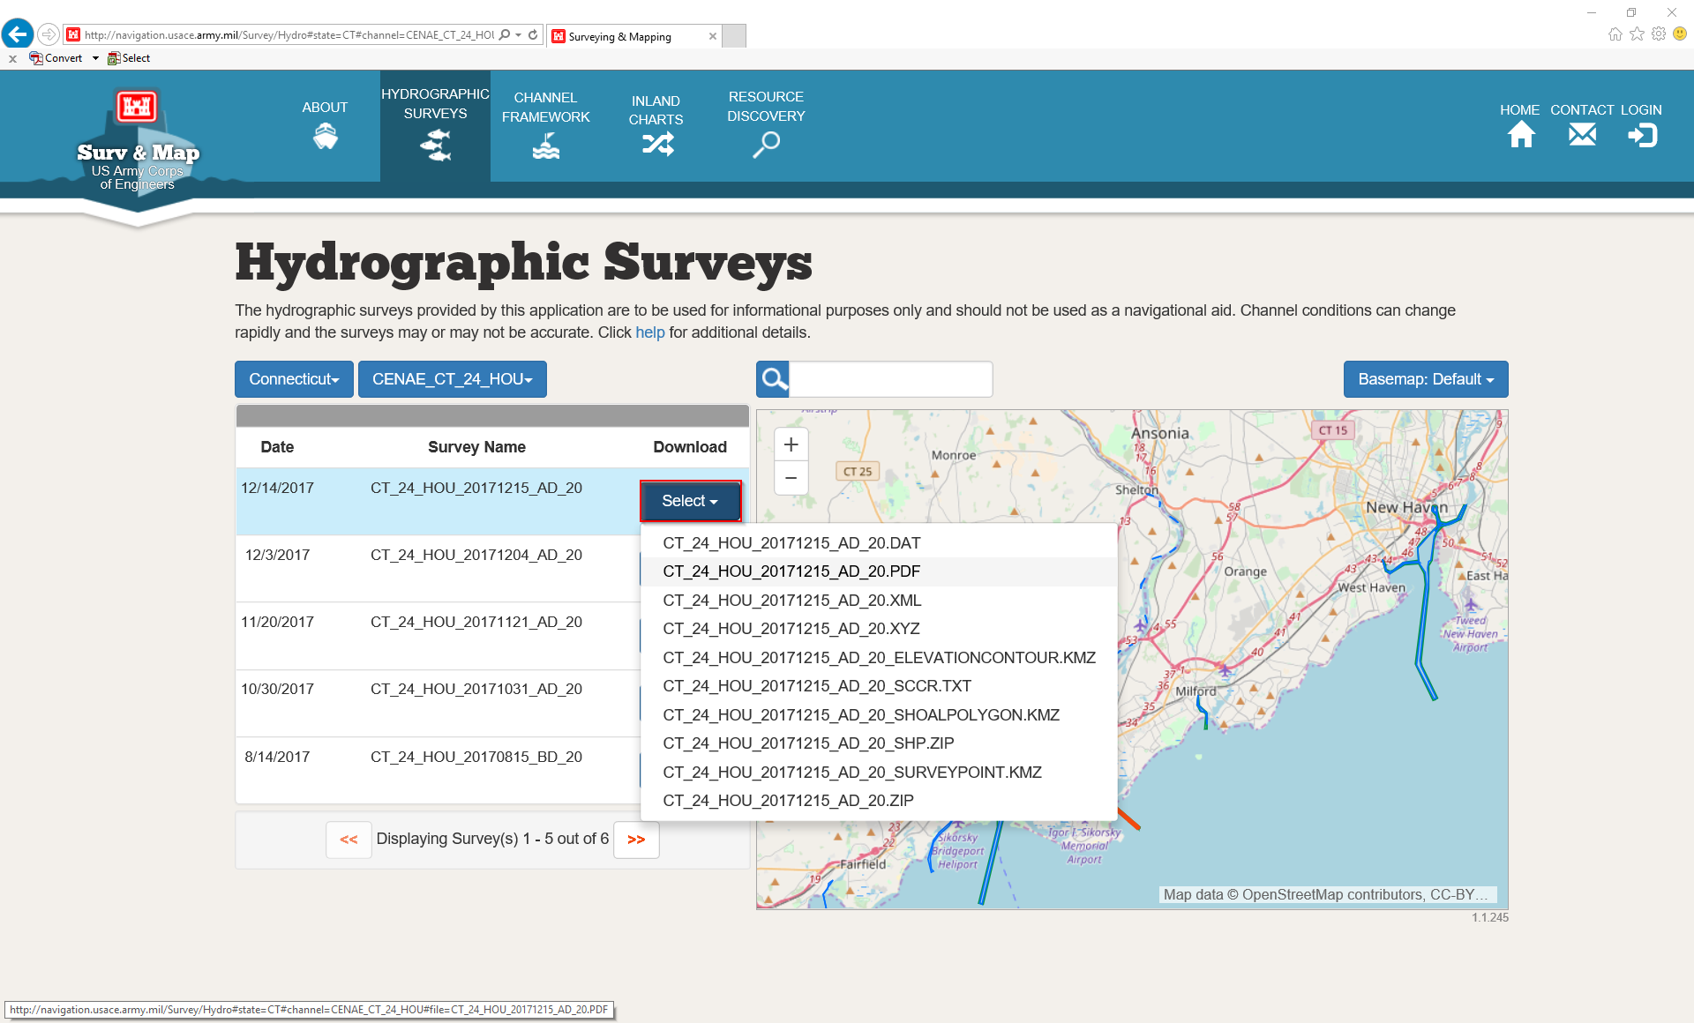
There are many download options! The final *.ZIP has everything available in one zip file
The *.PDF includes a layout with legend, scale, and other ancillary features (shoalest soundings, field targets, and contours)
The *.XYZ is the survey data and the associated metadata is located in the *.XML file
The *.KMZ files (contours, shoaling polygons, and soundings) open in Google Earth (shapefile versions are in the *SHP.ZIP)
The SCCR.TXT is a type of channel condition report

Slide 11
New England District Webpage
*Any New England project not yet posted to eHydro will be here*
*All CCI reports and combined survey PDFs will be here*
(eHydro SCCR reports and survey PDFs are created for the individual xyz dataset)

Slide 12
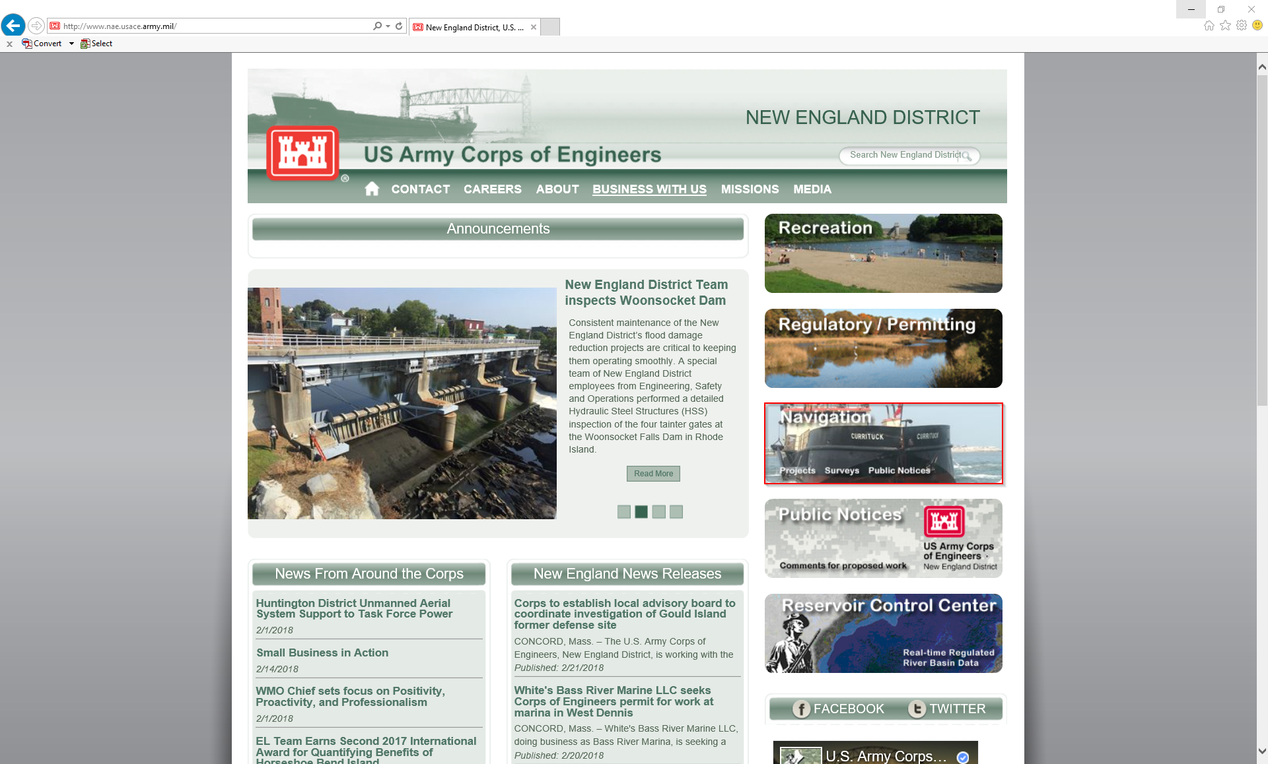
New England District Public Website: www.nae.usace.army.mil
Click “Navigation”

Slide 13
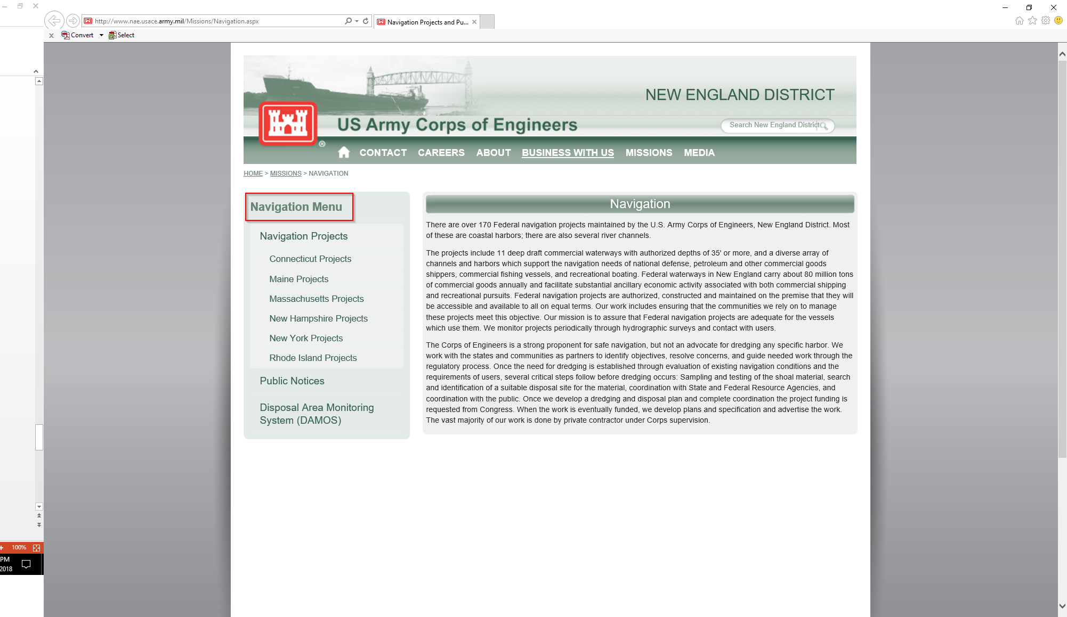
Click on Navigation Menu, Navigation Projects, and select state of interest

Slide 14
